Slide 1
BLOCKCHAIN &
CRYPTOCURRENCY
Breaking down the technology, its potential, and its pitfalls
Samuel James Mack | Post University | CIS 311 | Vincent Tran
Notes:
Today I want to talk about blockchain and cryptocurrency - two terms that get thrown around a lot but rarely get explained clearly. Whether you work in finance, healthcare, logistics, or anywhere else, this technology is likely to touch your industry in the next few years. My goal here is to cut through the noise and give you a grounded picture of what it actually does, what it could mean for your work, and where the real risks lie.

Slide 2



WHAT IS BLOCKCHAIN?
A Shared Ledger
Locked & Verified
No Middleman
Think of it like a Google Doc that thousands of computers share but nobody can delete or alter what's already been written.
Each transaction is bundled into a "block" and chained to the one before it. Changing one block would break every block after it.
No bank, no government, no central authority owns it. The network itself keeps it honest through math and consensus.
Block 1
Block 2
Block 3
Notes:
The simplest way I can explain a blockchain: imagine a shared spreadsheet that lives on thousands of computers at once. Every transaction gets recorded in a block, and each block locks onto the one before it - forming a chain. Because no single person or company owns it, there's no central point to hack or manipulate. Cryptocurrency is just one application built on top of this. Bitcoin, Ethereum, and others use blockchain to move money without banks. But as we'll see, the technology goes far beyond digital coins.

Slide 3


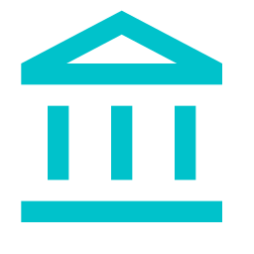

WHERE IT CREATES REAL VALUE
Beyond Finance
Healthcare
Patient records that follow you from hospital to hospital, securely and instantly.
Supply Chain
Track a product from factory floor to store shelf - every step verified and timestamped.
Government
Tamper-proof voting systems and land registries that can't be quietly altered.
Sustainability
Verified carbon credits that prove a company's environmental commitments are real.
Notes:
The most exciting thing about blockchain isn't Bitcoin - it's everything else. In healthcare, a blockchain-based patient record system means your medical history travels with you securely, without a hospital fax machine. In supply chains, companies like Walmart already use blockchain to trace food products from farm to store shelf in seconds instead of days. Governments are piloting it for land registries and voting systems in places where document fraud is a serious problem. And in sustainability, it offers a way to verify carbon offsets that are actually real rather than just claims on paper. The market reflects this: blockchain investment is moving fast across almost every sector.

Slide 4

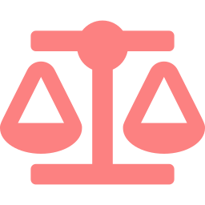


THE REAL CHALLENGES
Energy Consumption
Regulation is a Moving Target
Bitcoin alone uses as much electricity as some small countries. Proof-of-work mining is computationally expensive by design, though newer protocols like Ethereum's "proof-of-stake" use far less power.
Governments are still figuring out how to treat crypto - as currency, property, or security. The rules differ by country and change frequently, creating real legal uncertainty for businesses.
Volatility & Speculation
Fraud & Irreversibility
Bitcoin has swung from $69,000 to under $16,000 in a single year. That kind of volatility makes cryptocurrency unreliable as a day-to-day payment method and risky as an investment.
Transactions cannot be undone. If you send funds to the wrong address or fall for a scam, there is no customer service line and no chargeback. The same features that make it secure also make mistakes permanent.
Notes:
None of this means blockchain is flawless. The energy issue is the one that gets the most attention, and it's legitimate: the original proof-of-work system behind Bitcoin is deliberately energy-intensive. Newer systems have addressed this, but the reputation has stuck. Regulation is another headache - especially for businesses trying to plan around rules that differ by country and shift year to year. Then there's volatility. Cryptocurrency is still largely a speculative asset, and its price swings make it difficult to use as a reliable medium of exchange. Finally, blockchain transactions are permanent. There is no undo button. Fraud and user error both carry real consequences with no recourse.

Slide 5


Key Takeaways
Blockchain is a tamper-resistant shared ledger - cryptocurrency is just one thing built on top of it.
The real opportunity is in industries like healthcare, logistics, and government, not just finance.
Energy use, regulation gaps, and irreversibility are legitimate concerns that need to be weighed carefully.
The technology is real and growing — the question isn't if it will matter, but how fast and in what form.
Notes:
Blockchain is not always a gimmick, but it's also not a magic fix. It's a genuinely useful piece of infrastructure that works best in situations where multiple parties need to share data without trusting a single central authority to manage it. Cryptocurrency is the highest-profile application, but probably not the most important one long term. For most organizations, the more relevant question is how blockchain-based record keeping, verification, or smart contracts might streamline something they're already working on. The challenges are real, but they're the kind that tend to get solved as technology matures.

